Slide 1
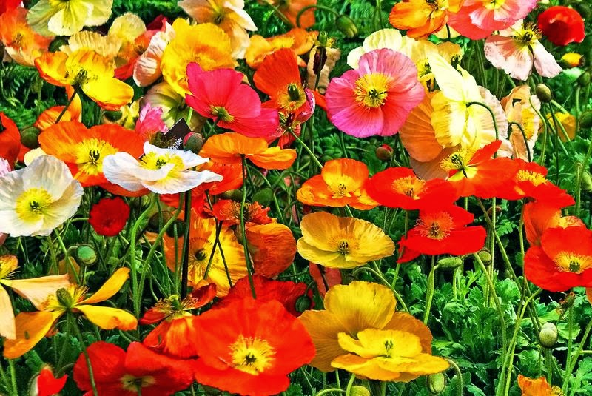
Project Website Construction
BCM Great Promise Style
CIS 3610 Web Design and Development Group 3: Brenda Menjivar
May 12, 2022

Slide 2
Agenda
Background
Live Presentation Website
Challenges

Slide 3
1. Background

Slide 4

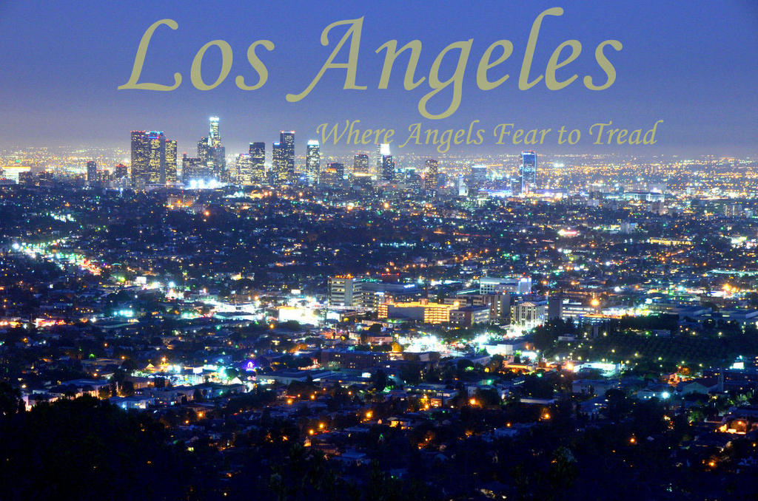
Background
BCM Great Promise Style is located at Los Angeles, California, USA close miles from the LA District Fashion.

Slide 5
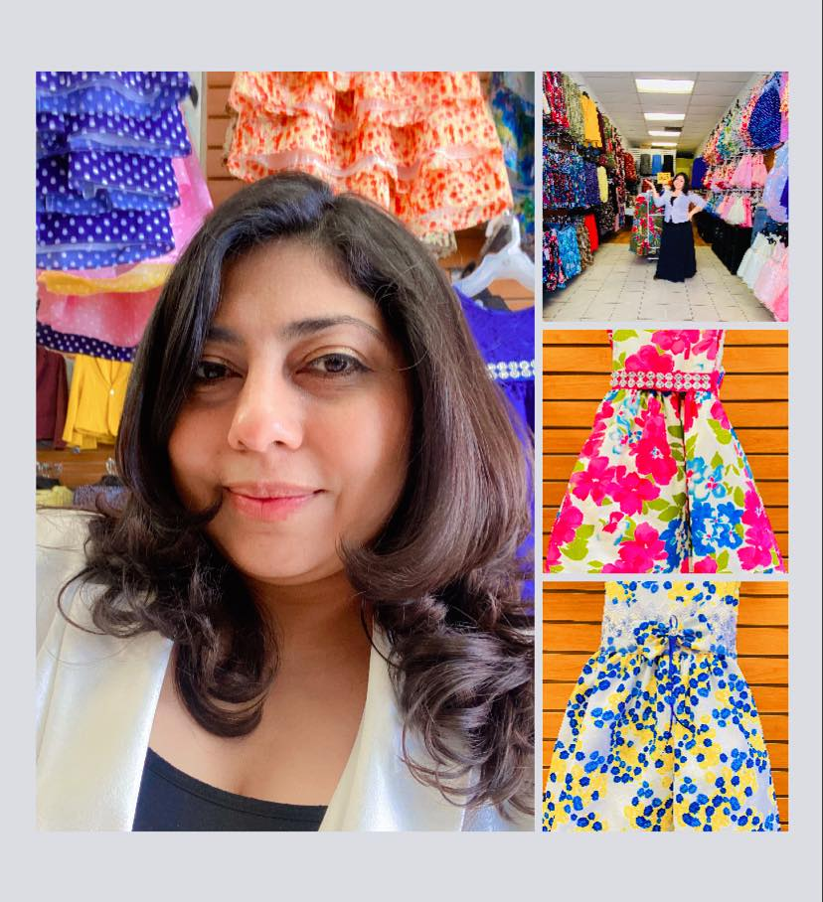
Background
However, BCM Great Promise Style is not well known because it is a new business in the area.
People don’t know about this brand and the amazing new dress for girls in the store.

Slide 6
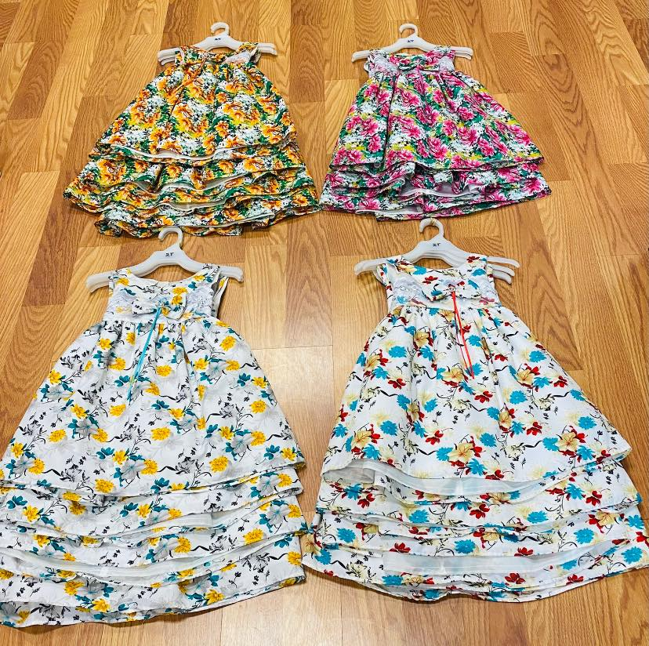
Background
The need for more
visitors,
shoppers,
customers,
and sales per year
Has increased BCM Great Promise Style the necessity to create a website to show its beautiful dress to the world.

Slide 7
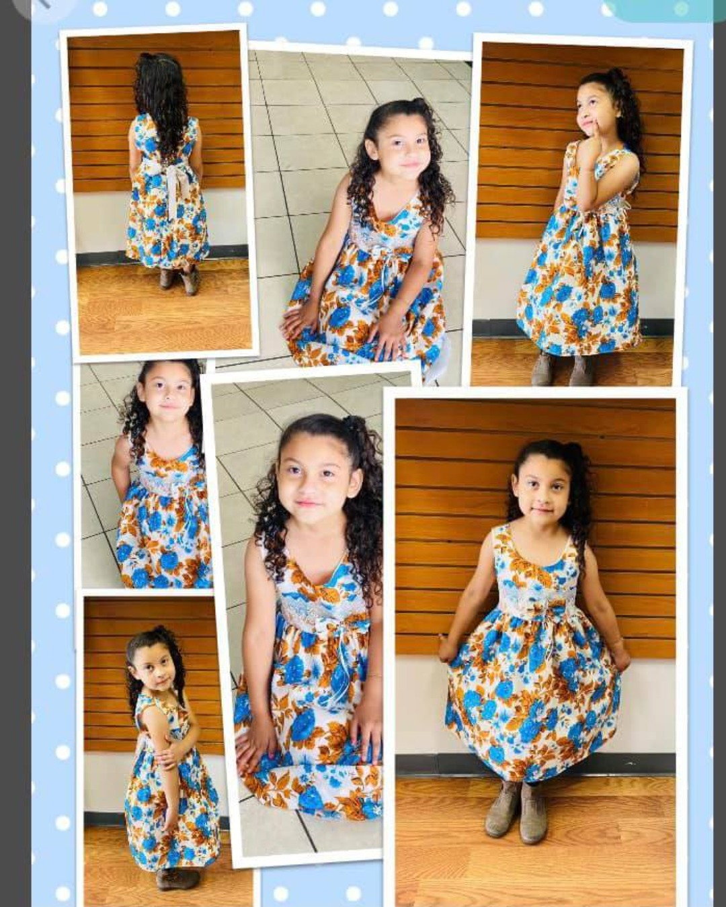
Business Value
The purpose of the website BCM Great Promise Style is to promote
A beautiful flower dress collection portraying life, love, beauty, and innocence,
Increase sales.

Slide 8
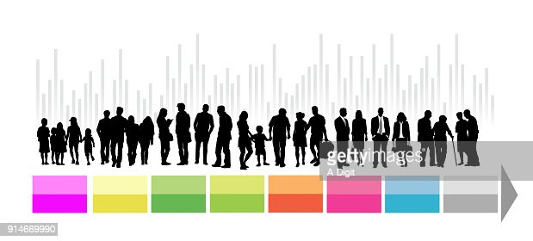
Target Audience
BCM Great Promise website’s target audience consists of people who like casual and fashion style dressing.
Demographics of the target audience include all ages.
The youngest to middle-aged adults, elderly, single individuals, couples, visitors, or shoppers traveling in groups.
Aims to attract international shoppers living outside USA with average to higher income.

Slide 9
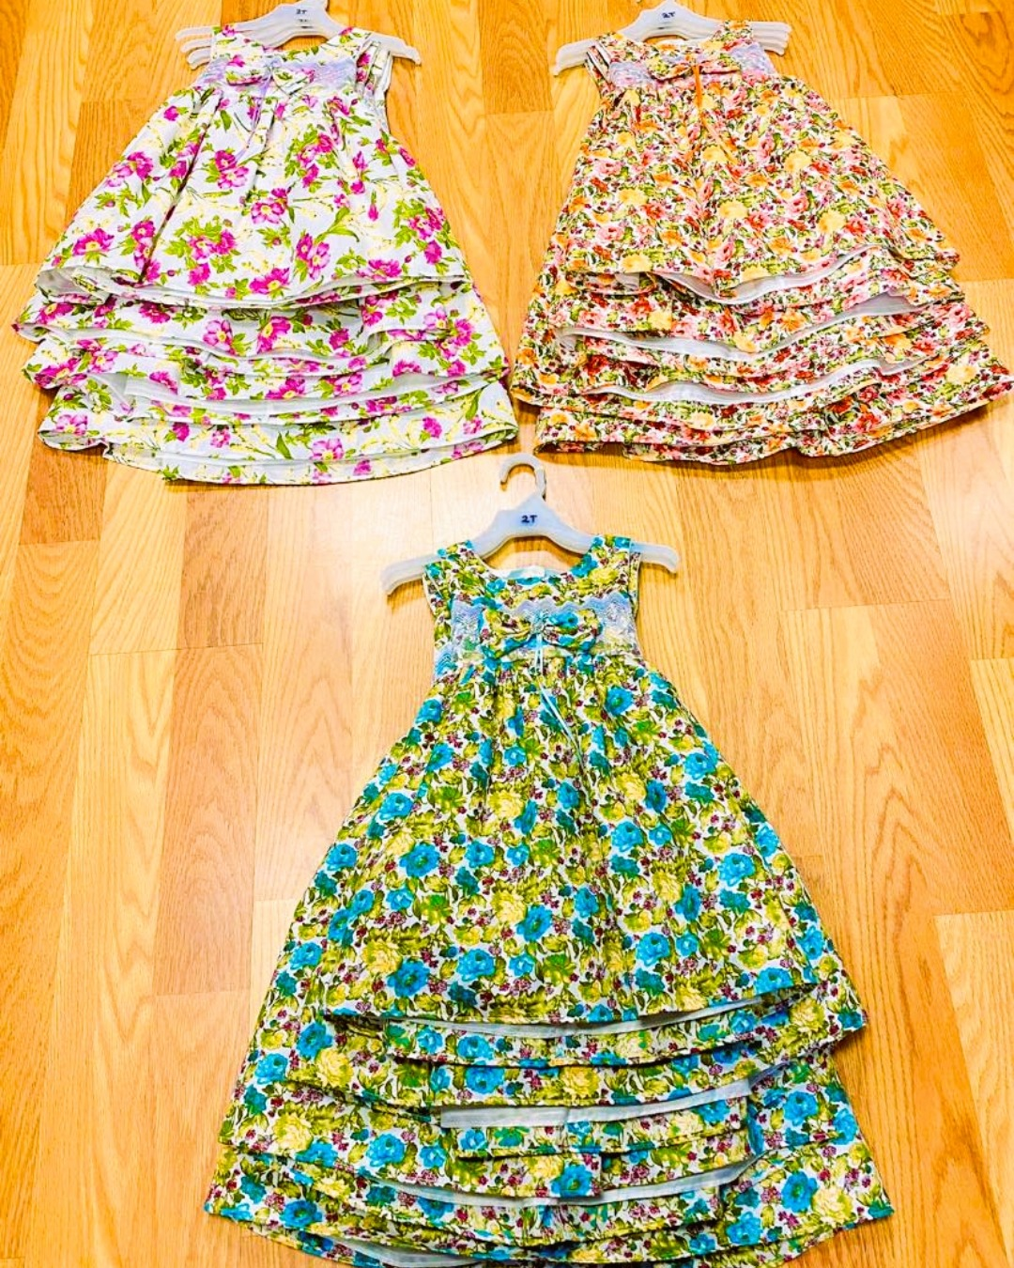
Visitors’ and Shoppers’ Motivations and Goals
BCM Great Promise website's visitors and shoppers are likely to be travelers looking for a beautiful and casual dress.
The perfect purchase or wonderful detail for someone special such as a little daughter, granddaughter, nice, cousin, or friend in a special location.

Slide 10
Visitors’ and Shoppers’ Motivations and Goals
Specific goals of the website’s visitors and shoppers may include to
know about BCM Great Promise Style
Contact BCM Great Promise Style for more information.

Slide 11
2. Live Presentation

Slide 12
BCM Great Promise Web
GitHub: Here is the Link to look and explore it
https://brendamenjivar-22.github.io/BCM-Great-Promise-Style/
https://brendamenjivar-22.github.io/BCM-Great-Promise-Style/

Slide 13
3. Challenges

Slide 14
Challenges
Whole Website construction has been a challenge
Video
Slides
Accordion
Resizing Images

Slide 15
Facing the Challenges
Video (Asking professor to help me)
Slides (reading the book, professor slides, and reviewing in class assignments)
Accordion ( Reviewing every detail of Lab #9: Café con Causa)
Resizing Images (Practicing until getting the perfect image)

Slide 16
Thanks For All Your Attention!!

